Slide 1

A 12-month detailed plan has been laid out with a clear emphasis on the key tasks to ensure seamless operations till launch
12- Month Execution Plan
Month 1
Month 2
Month 3
Month 4
Month 5
Month 6
Month 7
Month 8
Month 9
Month 10
Month 11
Month 12
Product Finalization
Card design, Tech Architecture
Design & Development
Application, Analytics, Backend APIs, Beta App
Gamified Rewards MVP
Badge System Setup, Levels and Reward Redemption Flows
Personalized Support Setup
Onboarding premium support team
Integrating Partners
Negotiation, defining SLAs
Power Rewards Campaign
Features and offers
Travel Fast-Track Roll out
Tie Up with Concierge & Airport Services
Marketing Pre Launch
Communication channels, positioning, influencer tie-ups, launch events
Continuous Initiatives (i.e., not dependent on timelines)
Regulatory compliances from SEBI, RBI and other related administrative bodies
Hiring and strategy roadmap for the next 10 years
Partnerships with airports, reward partners, PSPs, card network etc.
Legend
Periodic Process
Permanent addition to service catalogue
15
Notes:
Implementation Plan

Slide 2
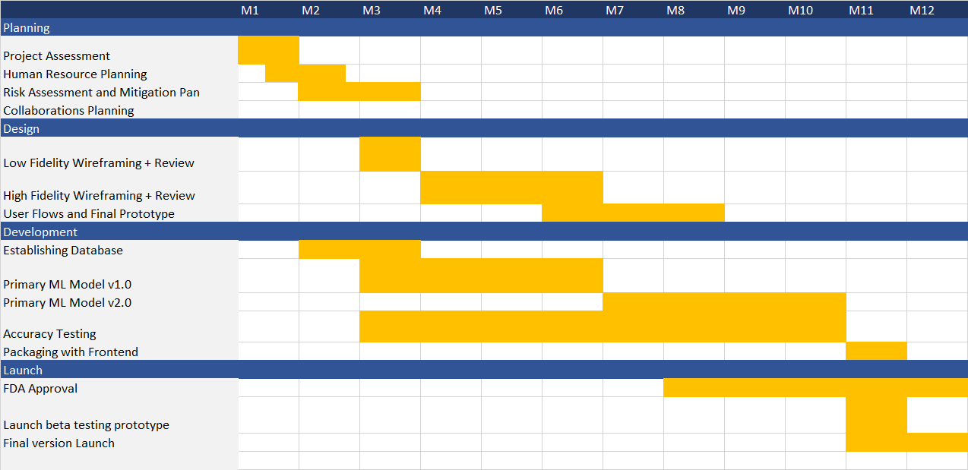

Slide 3
 | 01 Jan | 02 Feb | 03 Mar | 04 Apr | 05 May | 06 Jun | 07 Jul | 08 Aug | 09 Sept | 10 Oct | 11 Nov | 12 Dec
Project Planning
Market Research
Project Scope Definition
Resource Allocation
Implementation
Development Phase
Quality Assurance
Compliance Checks
Project Closure
Final Review
Documentation
Project Handover
January 1 to March 10
January 1 to February 15
January 25 to February 10
February 16 to March 10
March 11 to August 15
March 11 to August 15
June 1 to July 15
July 16 to August 15
August 16 to November 30
August 16 to September 5
September 6 to October 15
October 16 to November 30
Yearly - GANTT Chart Template

Slide 4










1 | 2 | 3 | 4 | 5 | 6 | 7 | 8 | 9 | 10 | 11 | 12 | 13 | 14 | 15 | 16 | 17 | 18 | 19 | 20 | 21 | 22 | 23 | 24 | 25 | 26 | 27 | 28 | 29 | 30 | 31
Task 1 Label
70%
Dec 2 – Dec 12
Task 2 Label
62%
Dec 5 – Dec 11
Task 3 Label
20%
Dec 11 – Dec 22
Task 4 Label
10%
Dec 19 – Dec 31
Task 5 Label
95%
Dec 16 – Dec 26
Task 6 Label
20%
Dec 23 – Dec 29
Today
Lorem Dolor
Lorem Dolor
Lorem Dolor
Lorem Dolor
Lorem Dolor
Lorem Dolor
completion
Project Roadmap - GANTT Chart Template

